Slide 1

Covid – 19 Impact : City of San Antonio/ Bexar County
Team 1:
Stephen Lane, Ankita Gautam, Joel Navarro, Lorena Martinez, Manuel Eduardo Sotelo Cervantes

Slide 2
DATA & CLEAN UP PROCESS
Texas Vaccination Rate: Bexar County Vaccination Rates
Single vs. Double Dose (Jan 2021 – Sept 2021)
Age Groups that were single and double dose.
Gender comparison of single and double dose.
Vaccination Status by race and ethnicity.
Fully vaccinated vs death rates.

Slide 3
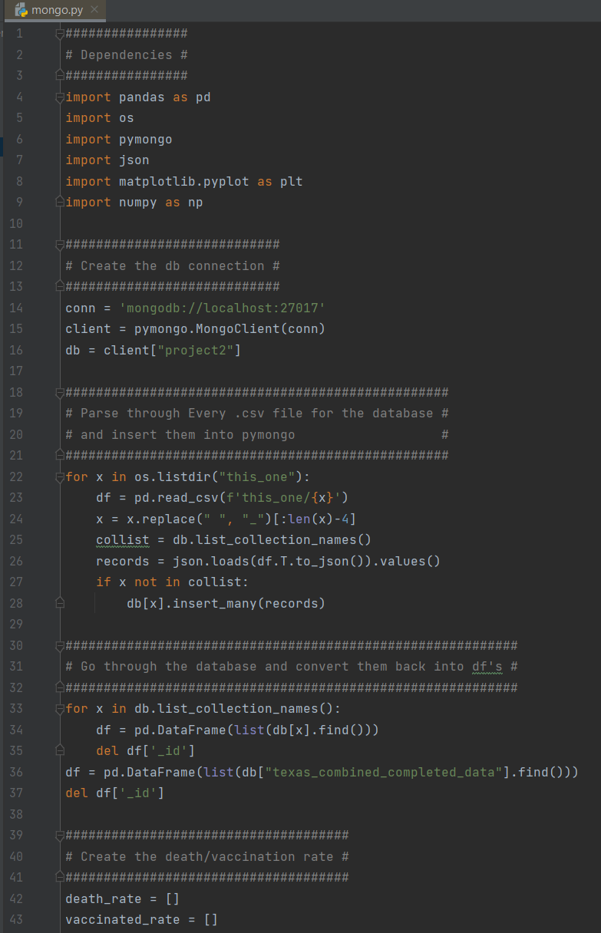
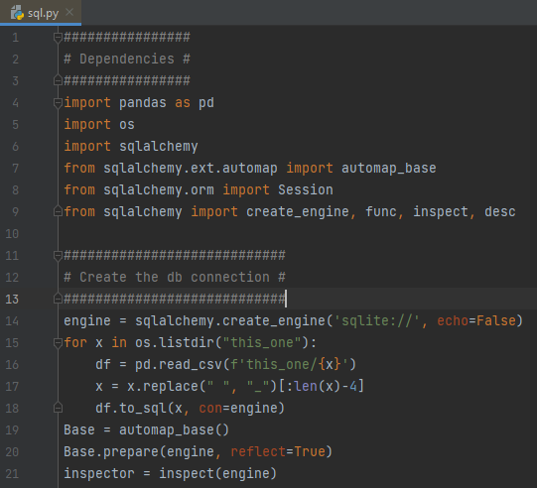
DATABASE CREATION
Team discussed advantages of SQL versus MongoDB
MongoDB was selected for the database after initial inspection of the data revealed csv files with differing data types with no easy ways to link the tables using schema.

Slide 4
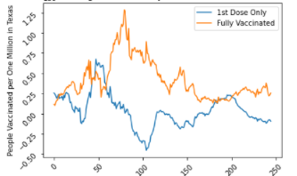
Texas Vaccine Uptake One Dose vs Fully Vaccinated (Timeframe : Jan 20, 2021 – Sept 21, 2021)
First and second dose are offset which can be expected due to the 21- day gap between doses.
How did we clean up data?
We removed the data entry errors by shortening the number of weeks (x-axis) to exclude a data entry error.
Would be interesting to see how vaccine rate corresponds with new variants.

Slide 5
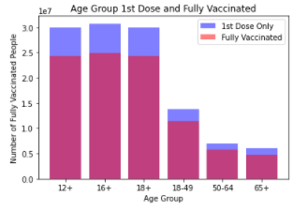
Age Comparison of single dose vs double dose
Relationship of Age correlation to Fully Vaccinated vs Single Dose
Percentage of total population by age group maybe better to measure than a count. Due to differences in age/population size.
Larger number of younger ages vaccinated due to higher population of 12-18yr old and lower number of elderly vaccinated due to higher risk of infection.

Slide 6
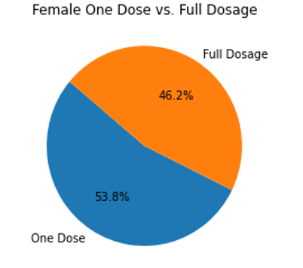
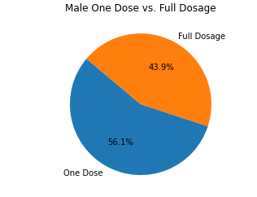
WHAT GENDER TO MOST LIKELY GET VACINATED?
56.1% of males got single dose of the vaccine compared to women at 53.8%
46.2% of women got double dose of the vaccine compared to men at 43.9%
Which means women are 2.3% more likely to get vaccinated compared to their gender counterparts, but men where 2.3% more likely to get one dose.

Slide 7

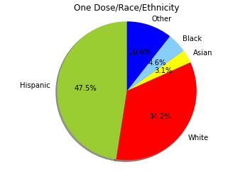
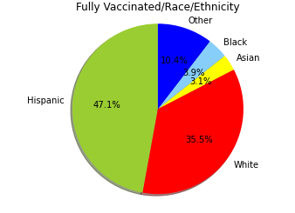
Vaccination Status by Race/Ethnicity
Pie charts highlight difference in vaccine uptake 1st to 2nd dose by Race/Ethnicity.
We seen that vaccine uptake between 1st and 2nd does is not significantly different than first dose percentages.

Slide 8
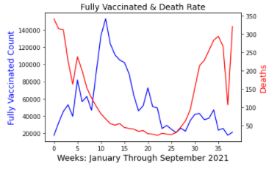
Fully Vaccinated & Mortality
As vaccination rate rose deaths per week fell.
As vaccination rates slowed and plateaued death per weeks rose.
More investigation analysis to needed to validate why deaths per week rose sharply.
Key questions to ask based on initial analysis of the graph:
Is death data reported consistently and is there variance in time of death to data entry?
Did death per week experience the sharp increase due to declining immunity in the vaccinated population?
Utilized dual scale line graph in order to display a proper visualization of vaccination vs. death rate.

Slide 9
CONCLUSION
In conclusion, we used MongoDB to create the database
From the data provided you can see that when vaccination percentage went up the death by covid percentage went down.
Women were 2.3% more likely to vaccinate.
The younger generation is more likely to be vaccinated compared to older generation.

